Slide 1
GetActive

Slide 2
Iteration 1 Overview
In this Iteration, we
Setup CI/CD workflow.
Implemented Register/Login functionality.
Implemented Activity functionality.(codes of frontend haven’t be merged)
Link to production server: http://18.219.48.189/

Slide 3
CI Workflow
setup and initialize database.
run backend unit tests.
build and start backend service.
run E2E tests for frontend.
save the test reports for downloading.

Slide 4
CD Workflow
Create docker images: database, backend, nginx
Upload images into Github Container Registry.
Log into production instance to download and deploy.
Security: two separated network, secrete credentials

Slide 5
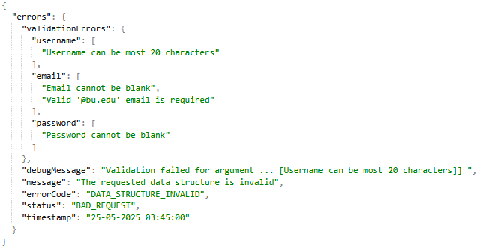
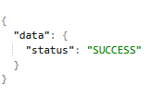
Register & Login (backend)
Available REST APIs
Restricted APIs
“/v1/login”
“/v1/activity”
“/v1/activies”
Unrestricted API
“/v1/register”
“/v1/health”
REST APIs are secured using JWT tokens for a stateless application.
Authenticated users have access to restricted APIs.
Authenticated users are those who have registered with the application.
Authorized users are those who have verified their email address after registration.
Implemented unified success and error response.
Notes:
JWT tokens were used to allow

Slide 6
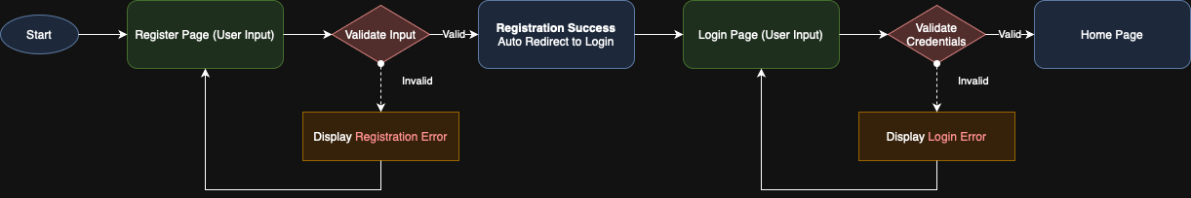
Register & Login (frontend)
use React Context mechanism to store authentication information
implement ProtectedRoute to protect components/pages
use Interceptor Pattern provided by Axios library to add token automatically.

Slide 7
Activity (backend)
API to create an activity with the following fields: name, location, description, start and end datetime.
POST /v1/activity
API to return all list activities
GET /v1/activities
API to search and return all activities containing similar names.
GET /v1/activity/{name}

Slide 8
QA
backend unit test
frontend E2E test

